Slide 1
CS112 : Introduction to Python Programming
Week 12: lab practice

Slide 2
Practice 1
{"grammer":["Python","C","Java","Go",np.nan,"SQL","PHP","Python"],"Score":[1,2,np.nan,4,5,6,7,10]}
1.将该字典创建为DataFrame
2.提取含有“Python”的行
3.输出所有的列名
4.修改第2列列名为“Popularity”
5.将空值用均值填充
6.统计每个语言出现的频率
7.将DataFrame的grammer列输出为list
8.将DataFrame保存为excel

Slide 3
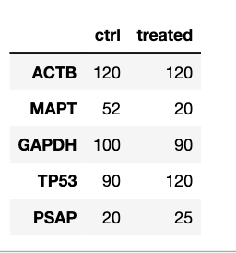
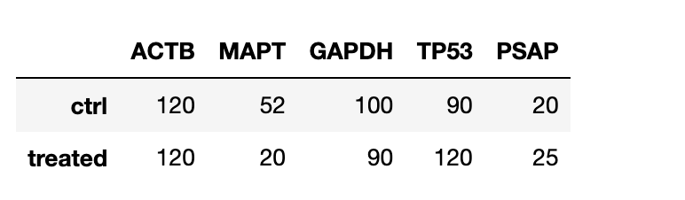
Practice 2
Generate 2 panda DataFrames for the following data.
genes = ['ACTB', 'MAPT', 'GAPDH', 'TP53', 'PSAP’]
ctrl = [120, 52, 100, 90, 20]
treated = [120, 20, 90, 120, 25]

Slide 4
Practice 3
Print the names of male students who failed the exam (score <60) by filtering the scores using Pandas, the data has been organized into a dictionary:
records = { 'Name': ['Mary', 'Maria', 'Anna', 'John', 'Jake', 'Joe' ],
'Gender': ['Female', 'Female', 'Female', 'Male', 'Male', 'Male'],
'Score': [88, 92, 56, 70, 55, 48] }

Slide 5
Practice 4
Create two 2x5 and 5x2 DataFrames using the following lists:
a = [1,2,3,4,5]
b = [6,7,8,9,10]
with row and column names ['a', 'b'] and ['A', 'B', 'C', 'D', 'E'], respectively.

Slide 6
Practice 5
You have collected a list of data science and algorithm marks from course assignments:
data = [['DS', 'Linked_list', 10],
['DS', 'Stack', 9],
['DS', 'Queue', 7],
['Algo', 'Greedy', 8],
['Algo', 'DP', 6],
['Algo', 'BackTrack', 5], ]
with column names ['Course', 'Session', 'Marks']. Calculate the mean mark for each course using Pandas.

Slide 7
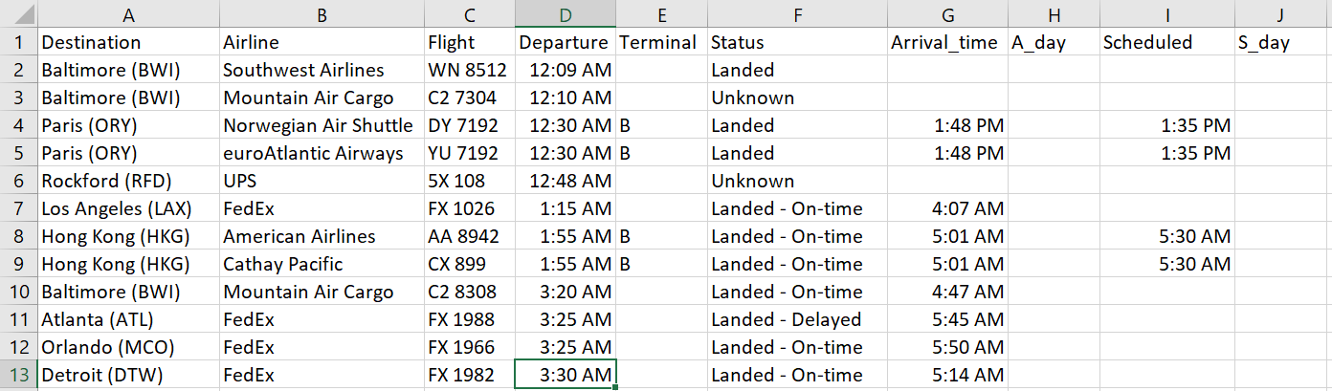
Practice 6
Find out the top five busiest destinations evaluated by total flight numbers or total unique airline numbers:
S12_ewr_Flights.csv

Slide 8
Practice 7
read screening.csv into DataFrame
1.生成列 高血压， Hypertension：
诊断标准：如果SBP>=140,或者 DBP>=90, 则为高血压
2. 生成列 肥胖 Obesity
如果BMI>=28,则为肥胖
3.根据年龄排序，统计各年龄段(50岁及以上，50岁以下人群)的高血压人数，肥胖人数。
4.比较不同年龄人群中，高血压患病率、肥胖患病率是否有差异？

